Slide 1
DATA SCIENCE BOOTCAMP
Session 7: Introduction to Web Scraping and API
Copyright © 2020 Exceed Philippines. All rights reserved

Slide 2
SESSION 7 OUTLINE
WEB SCRAPING
HTML
APPLICATION PROGRAMMING INTERFACE (API)
Copyright © 2020 Exceed Philippines. All rights reserved

Slide 3
SESSION 7 OUTLINE
WEB SCRAPING
HTML
APPLICATION PROGRAMMING INTERFACE (API)
Copyright © 2020 Exceed Philippines. All rights reserved

Slide 4
WEB SCRAPING
Web scraping is the process of using bots to extract content and data from a website.
It extracts underlying HTML code and, with it, data stored in a database. The scraper can then replicate entire website content elsewhere.
Copyright © 2020 Exceed Philippines. All rights reserved
https://www.imperva.com/

Slide 5
WEB SCRAPING
Web scraping is the process of using bots to extract content and data from a website.
It extracts underlying HTML code and, with it, data stored in a database. The scraper can then replicate entire website content elsewhere.
Copyright © 2020 Exceed Philippines. All rights reserved
https://www.imperva.com/

Slide 6
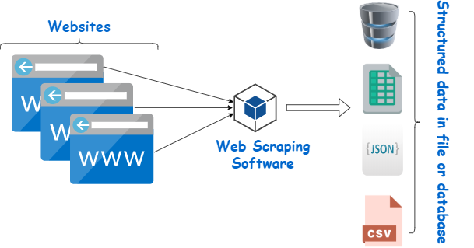
WEB SCRAPING
Copyright © 2020 Exceed Philippines. All rights reserved
Google Images: “Web Scraping”

Slide 7
SESSION 7 OUTLINE
WEB SCRAPING
HTML
APPLICATION PROGRAMMING INTERFACE (API)
Copyright © 2020 Exceed Philippines. All rights reserved

Slide 8
HTML
HTML is the standard markup language for Web pages.
With HTML you can create your own Website.
Copyright © 2020 Exceed Philippines. All rights reserved
https://www.w3schools.com/html/

Slide 9
HTML
HTML is the standard markup language for Web pages.
With HTML you can create your own Website.
Copyright © 2020 Exceed Philippines. All rights reserved
https://www.w3schools.com/html/

Slide 10
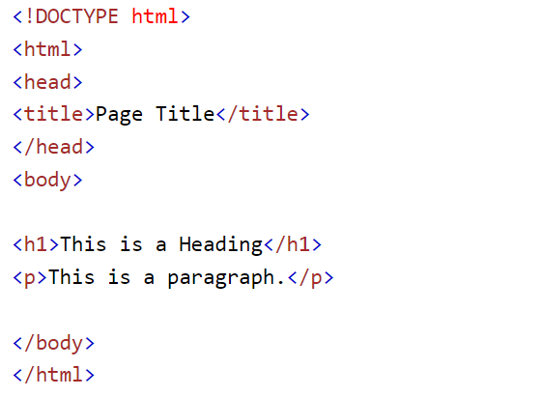
HTML Example
Copyright © 2020 Exceed Philippines. All rights reserved
https://www.w3schools.com/html/
Notes:
<!DOCTYPE html> <html> <head> <title>Page Title</title> </head> <body> <h1>This is a Heading</h1> <p>This is a paragraph.</p> </body> </html>

Slide 11
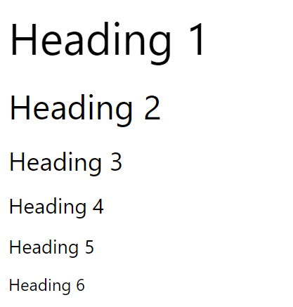
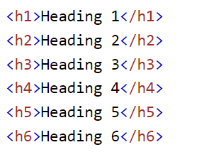
HTML Example - Headings
Copyright © 2020 Exceed Philippines. All rights reserved
https://www.w3schools.com/html/
Notes:
HTML headings are titles or subtitles that you want to display on a webpage.

Slide 12
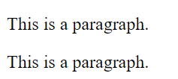
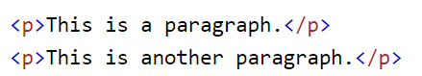
HTML Example - Paragraph
Copyright © 2020 Exceed Philippines. All rights reserved
https://www.w3schools.com/html/
Notes:
The HTML <p> element defines a paragraph.
A paragraph always starts on a new line, and browsers automatically add some white space (a margin) before and after a paragraph.

Slide 13
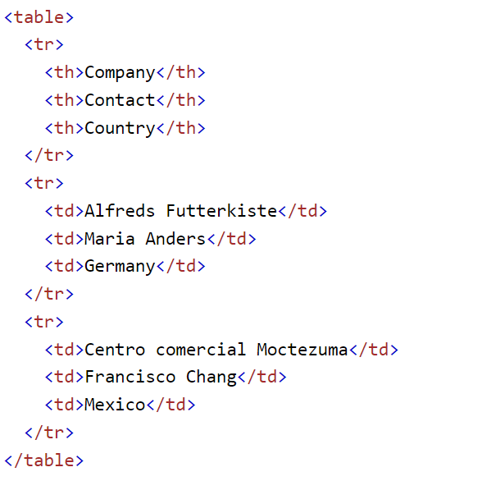
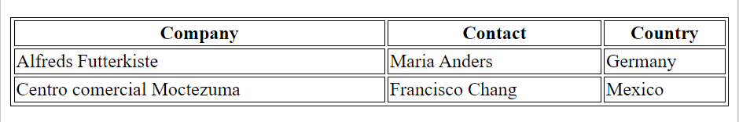
HTML Tables
Copyright © 2020 Exceed Philippines. All rights reserved
https://www.w3schools.com/html/
Notes:
A table in HTML consists of table cells inside rows and columns. Each table cell is defined by a <td> and a </td> tag. td stands for table data. Each table row starts with a <tr> and ends with a </tr> tag. Sometimes you want your cells to be headers. In those cases use the <th> tag instead of the <td> tag
<!DOCTYPE html>
<html>
<style>
table, th, td {
border:1px solid black;
}
</style>
<body>
<h2>A basic HTML table</h2>
<table style="width:100%">
<tr>
<th>Company</th>
<th>Contact</th>
<th>Country</th>
</tr>
<tr>
<td>Alfreds Futterkiste</td>
<td>Maria Anders</td>
<td>Germany</td>
</tr>
<tr>
<td>Centro comercial Moctezuma</td>
<td>Francisco Chang</td>
<td>Mexico</td>
</tr>
</table>
<p>To undestand the example better, we have added borders to the table.</p>
</body>
</html>

Slide 14
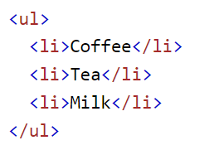
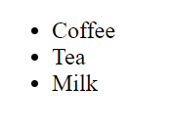
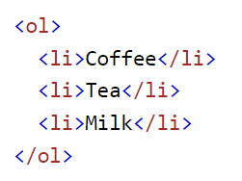
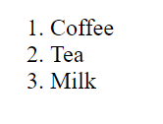
HTML Lists
Copyright © 2020 Exceed Philippines. All rights reserved
https://www.w3schools.com/html/
Notes:
HTML lists allow web developers to group a set of related items in lists.
<ul> <li>Coffee</li> <li>Tea</li> <li>Milk</li> </ul>
<ol> <li>Coffee</li> <li>Tea</li> <li>Milk</li> </ol>

Slide 15
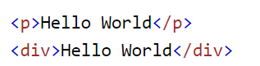
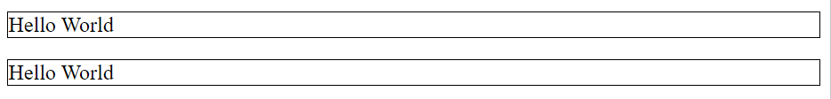
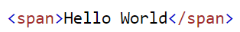
HTML Block and Inline
Copyright © 2020 Exceed Philippines. All rights reserved
https://www.w3schools.com/html/
Notes:
A block-level element always starts on a new line, and the browsers automatically add some space (a margin) before and after the element.
A block-level element always takes up the full width available (stretches out to the left and right as far as it can).
-----
An inline element does not start on a new line.
An inline element only takes up as much width as necessary.
CODE:
<p style="border: 1px solid black">Hello World</p>
<div style="border: 1px solid black">Hello World</div>
<p>This is an inline span <span style="border: 1px solid black">Hello World</span> element inside a paragraph.</p>

Slide 16
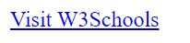
HTML Attributes
Copyright © 2020 Exceed Philippines. All rights reserved
https://www.w3schools.com/html/
Notes:
All HTML elements can have attributes
Attributes provide additional information about elements
Attributes are always specified in the start tag
Attributes usually come in name/value pairs like: name="value“
-----
<a href="https://www.w3schools.com">Visit W3Schools</a>

Slide 17
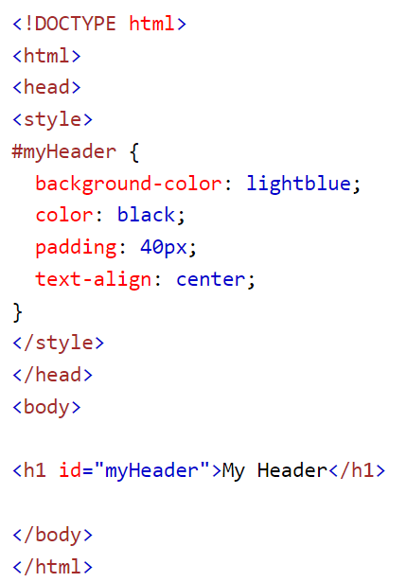
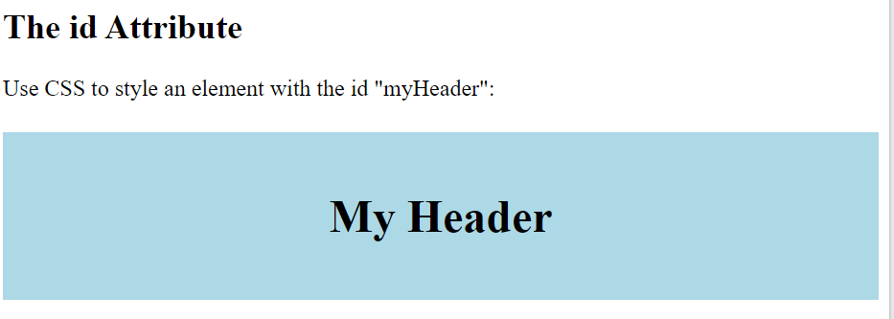
HTML Id
Copyright © 2020 Exceed Philippines. All rights reserved
https://www.w3schools.com/html/
Notes:
The id attribute specifies a unique id for an HTML element. The value of the id attribute must be unique within the HTML document.

Slide 18
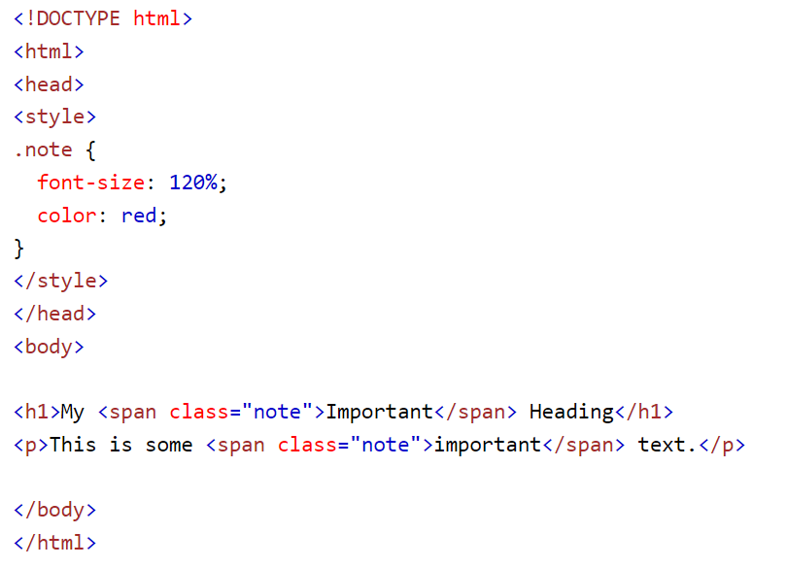
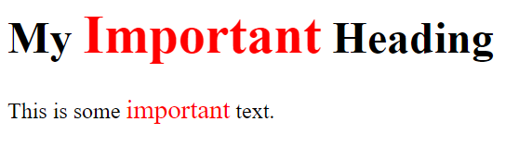
HTML Classes
Copyright © 2020 Exceed Philippines. All rights reserved
https://www.w3schools.com/html/
Notes:
The HTML class attribute is used to specify a class for an HTML element.
Multiple HTML elements can share the same class.

Slide 19
SESSION 7 OUTLINE
WEB SCRAPING
HTML
APPLICATION PROGRAMMING INTERFACE (API)
Copyright © 2020 Exceed Philippines. All rights reserved

Slide 20
API
API stands for Application Programming Interface.
In the context of APIs, the word Application refers to any software with a distinct function. Interface can be thought of as a contract of service between two applications. This contract defines how the two communicate with each other using requests and responses.
Copyright © 2020 Exceed Philippines. All rights reserved
aws.amazon.com

Slide 21
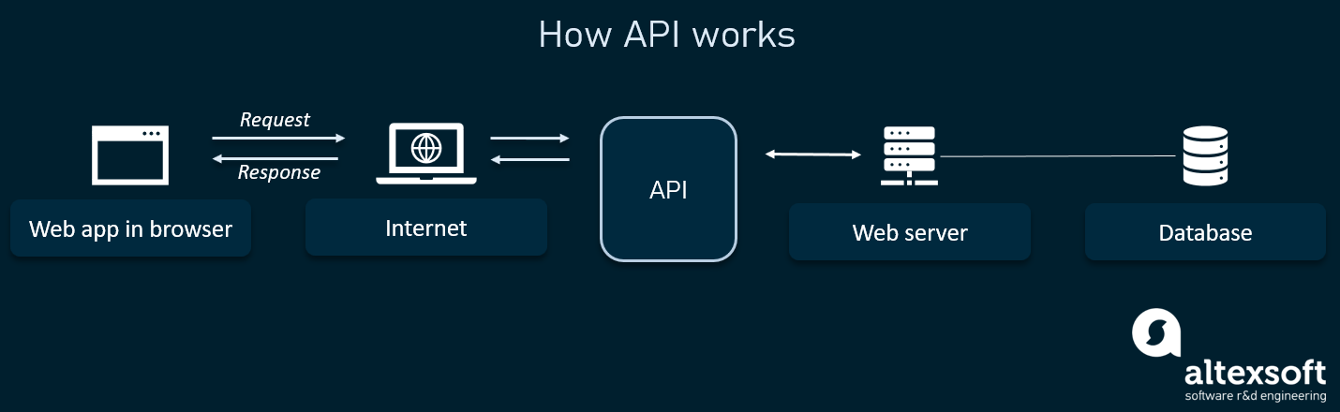
API
Copyright © 2020 Exceed Philippines. All rights reserved
Google Images: “API”

Slide 22

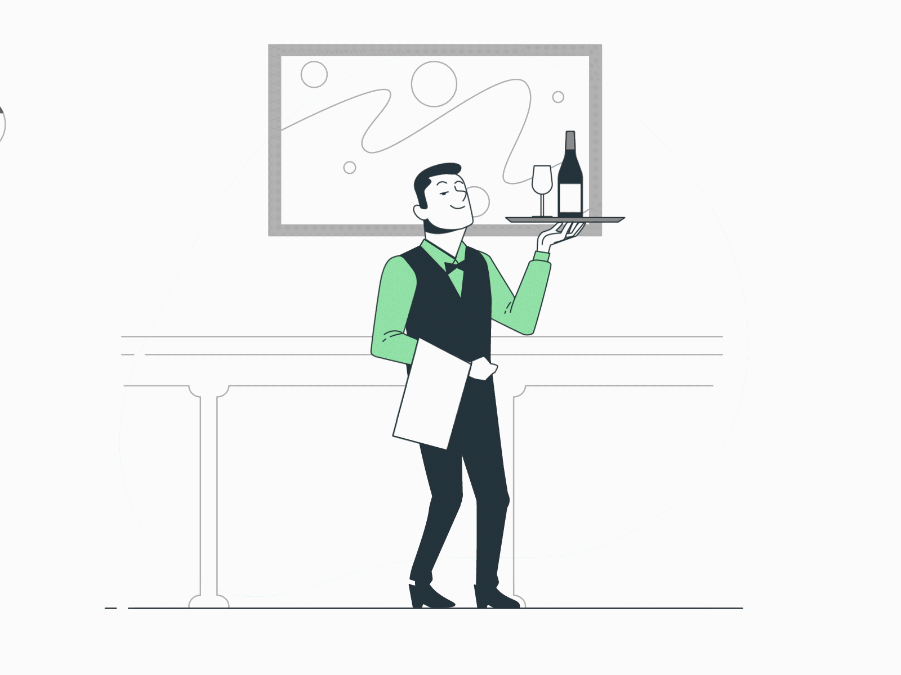

API
Customer
Waiter
Chef
FRONT-END
(APPLICATION)
API
(ENDPOINTS)
BACK-END
(SERVER/DATABASE)
Copyright © 2020 Exceed Philippines. All rights reserved
aws.amazon.com

